Slide 1
Optimizing e-commerce operations for priority customers
MGMT 59000 Final Project
Notes:
Amurtha
The STEM Store, a pioneering e-commerce entity dedicated to enhancing educational experiences through specialized STEM tools. In its pursuit of excellence and expansion into new cities, it encountered challenges namely delivery delays, determining loyal customers, rising competition, vendor efficiency and driver efficiencies.
Our current project is laser-focused on elevating customer satisfaction for our valued priority customers, utilizing a refined approach based on RFM analysis, and meticulous delay examination. We're expanding our data analytical horizon to encompass a full year, integrating price details, and leveraging advanced SQL for profound impact analysis.
Our goals are:
1) to significantly enhance priority customer satisfaction,
2) minimize delays
3) streamline operational efficiencies.
Through data-driven decisions in vendor, driver, and capacity allocations, we are not just aiming to reduce costs per delivered order but also to fortify our market standing, ensuring unparalleled customer satisfaction and operational superiority.

Slide 2






Team
Saurav S Borah
Bhavan Sekar
Amrutha Gabbitha
Anurati Kulkarni
Liana Simopoulos
Notes:
Amurtha
Introducing our team of 6!

Slide 3

Project Description
The STEM store is an e-commerce platform for educational tools
Upon expansion into new cities, they faced operational hurdles like delayed deliveries and now their main goal is CUSTOMER RETENTION
This project proposes upgrading their database system as well as enhancing their analytical capabilties
RFM Analysis: Advanced SQL queries are used to recognize priority customers and strategise our approach to cater to those zip codes using RFM Metrics
Proposing Dynamic Vendor and Driver allocation: Currently the process of assigning vendor and driver is manual which leads to inefficiencies, With the help of SQL queries, we re-allocate the vendors and drivers efficiently to meet our objectives
KPIs of the project: Reduction in Cost Per Order (CPO), Reduction in Delays (Get your order within Promised Date) and Driver count.
Notes:
Amrutha

Slide 4
Datasets
We generated synthetic data based on the data we had. The tables are:
1.Out_For_Delivery
2.Customers
3.Orders
4.Products
5.Fleet
6.Vendor Rate Card
7.Distance
Notes:
Amrutha

Slide 5
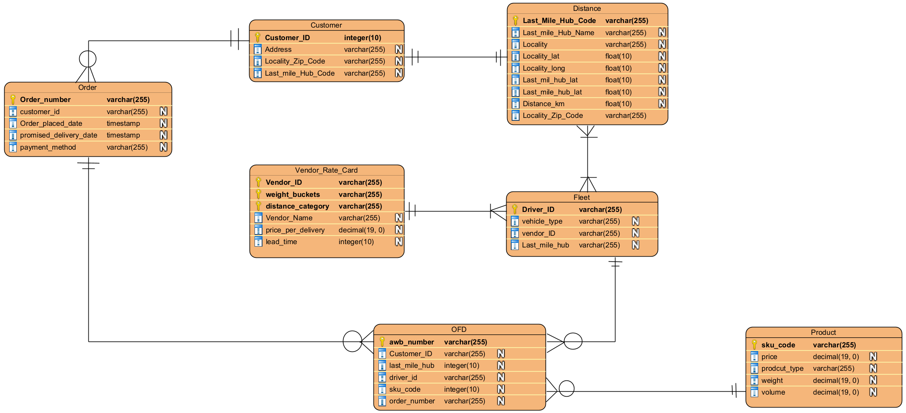
Entity Relationship Diagram
Notes:
Bhaven
- Order Table:
- Contains primary details of orders such as order number, customer ID, order placement date, promised delivery date, and payment method.
- Customer Table:
- Holds customer-related information including customer ID, address, locality zip code, and last mile hub code.
- Distance Table:
- Details about distances such as last mile hub code and name, locality details with latitude and longitude, and distance in kilometers.
- Vendor Rate Card Table:
- Provides vendor-specific data like vendor ID, weight buckets, distance category, vendor name, price per delivery, and lead time.
- Fleet Table:
- Includes information about the fleet, like driver ID, vehicle type, vendor ID, and the last mile hub they are associated with.
- Product Table:
- Contains product details such as SKU code, price, product type, weight, and volume.
- OFD (Out for Delivery) Table:
- Captures delivery-specific information including airway bill number (awb_number), customer ID, last mile hub, driver ID, SKU code, and order number.
- Relationships:
- The Order table is linked to the Customer table, indicating that orders are tied to specific customers.
- The OFD table is linked to several tables such as the Customer table, suggesting tracking of customer deliveries, and the Fleet table, indicating which fleet item (e.g., vehicle, driver) is associated with the delivery.
- The Product table stands alone without direct links to other tables in this diagram, which may suggest it is related through a transactional table not shown in this ERD.

Slide 6
Data preprocessing
Requirement​​
Data extrapolation
Identify all possible circumstances that can occur in Production
Perform sanity test of each of them
Types of data processing​​
Data genesis
Bootstrapping
Defining relationships
Tech stack
Python
SQL
Outcomes
Tables with ideal relationship schemas
Outliers for sanity testing the production efficiency
Notes:
Bhaven

Slide 7
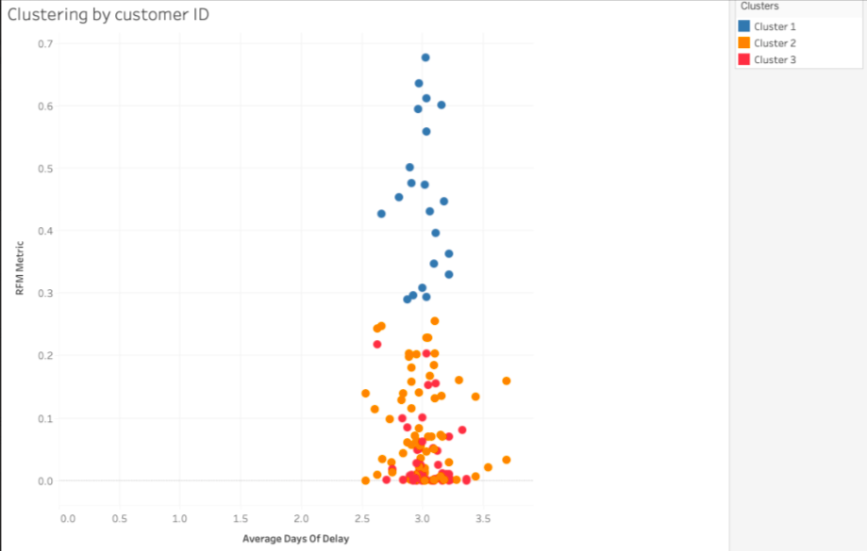
Approach
Database
Dynamic Vendor Allocation
Vendor Inefficiency
Cost Analysis
Customer Retention (Reduce Delays)
Driver allocation
TARGET
RFM Analysis
(Clustering with Top 100 Zipcodes to target the Loyal Customer base)
Vendor misallocation
Delay Analysis
Vehicle Capacity optimization
Notes:
First, we recognize top 100 zip codes by RFM metric. This will give us a subset of cluster (group of zipcodes) to focus our analysis on by identifying high value customers
Then, we allocate vendors who have good ratings and lower costs to our priority orders. This will have the effect of reducing delays and reducing costs.
Driver Allocation: Driver allocation is done to so as to make sure all orders going to one zipcode are assigned to a single driver, and multiple drivers do not deliver to same customer of a single day
Capacity Utilization: By making sure driver and vendor allocation is efficiently done, we make sure the delays are controlled due to vendor misallocation and our cost per delivery is reduced, also increasing the vehicle capacity utilization thus reducing the number of drivers required to delivery the packages on a single day.
Final output will have reduced company-caused delays (due to vendor misallocation) and reduce (CPO) for priority areas.

Slide 8



RFM to recognize loyal customers
We recognize priority customers by using the following criteria:
Recency of Last Order
Frequency of Ordering
Monetary Value provided to company
RFM is percentile rank which ranges from 0 to 1 The value closer to 0 is a more loyal customer
We group them by zip codes and thus we have the top 100 zip codes by RFM metric
Notes:
Bhaven
- Metric Calculation:
- Recency: Identified by calculating the last order date for each customer.
- Frequency: Measured by counting the total number of orders each customer has placed.
- Monetary Value: Computed by summing up the total amount spent by each customer.
- These metrics provide a basis for understanding customer behavior and purchasing patterns.
- Ranking and Scoring:
- Customers are ranked based on each of the three key metrics: recency, frequency, and monetary value.
- A new column, 'RFM_Metric', is introduced in the customer table to represent the composite RFM score for each customer, which is calculated by multiplying the individual ranks of recency, frequency, and monetary metrics.
- Normalization and Segmentation:
- The RFM metric scores are normalized to a scale between 0 and 1 to ensure consistency and facilitate comparison across customers.
- The top 100 zipcodes with the lowest RFM metric scores are identified for further analysis, highlighting areas with potentially lower customer engagement or spending.
- Strategic Application:
- This comprehensive RFM analysis aids in segmenting customers based on their buying habits, offering crucial insights for targeted marketing strategies.
- It enables the development of tailored customer relationship management initiatives to enhance engagement and optimize marketing efforts within the e-commerce delivery system.
Through this structured approach, the analysis leverages RFM metrics to derive actionable insights into customer behavior, enabling more informed decision-making in marketing and customer relationship strategies.

Slide 9
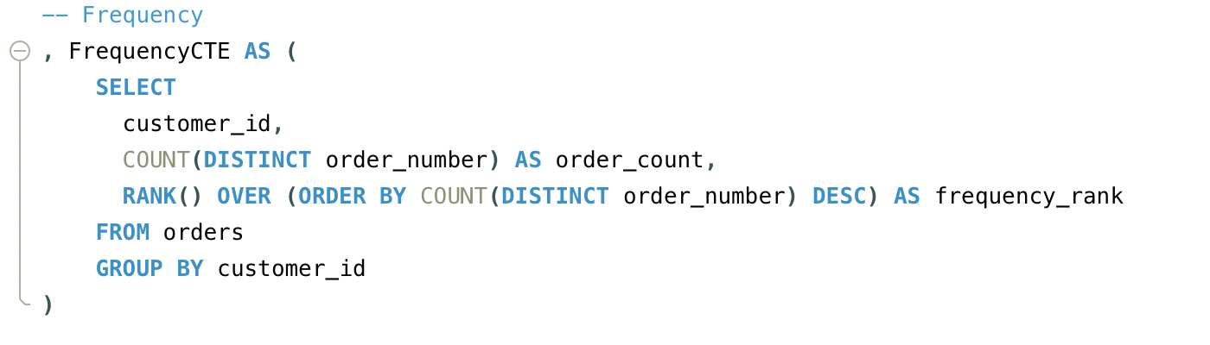
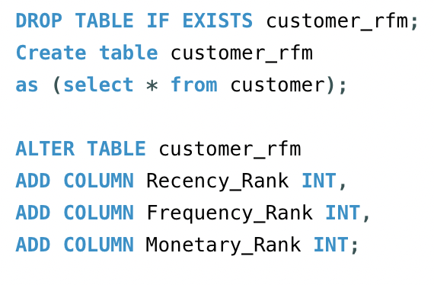
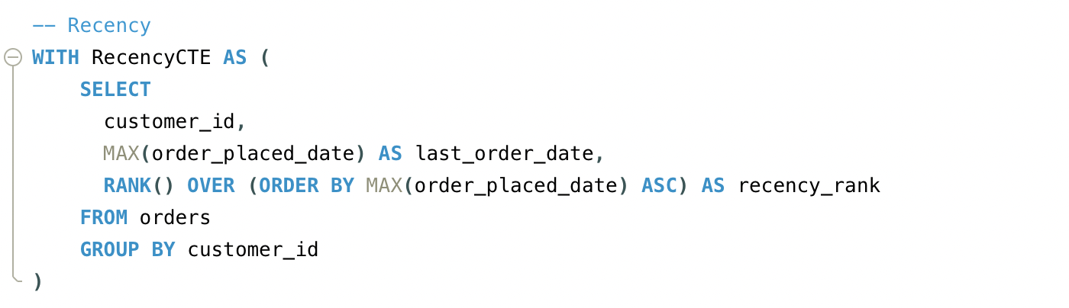
RFM Query
Notes:
Bhaven

Slide 10
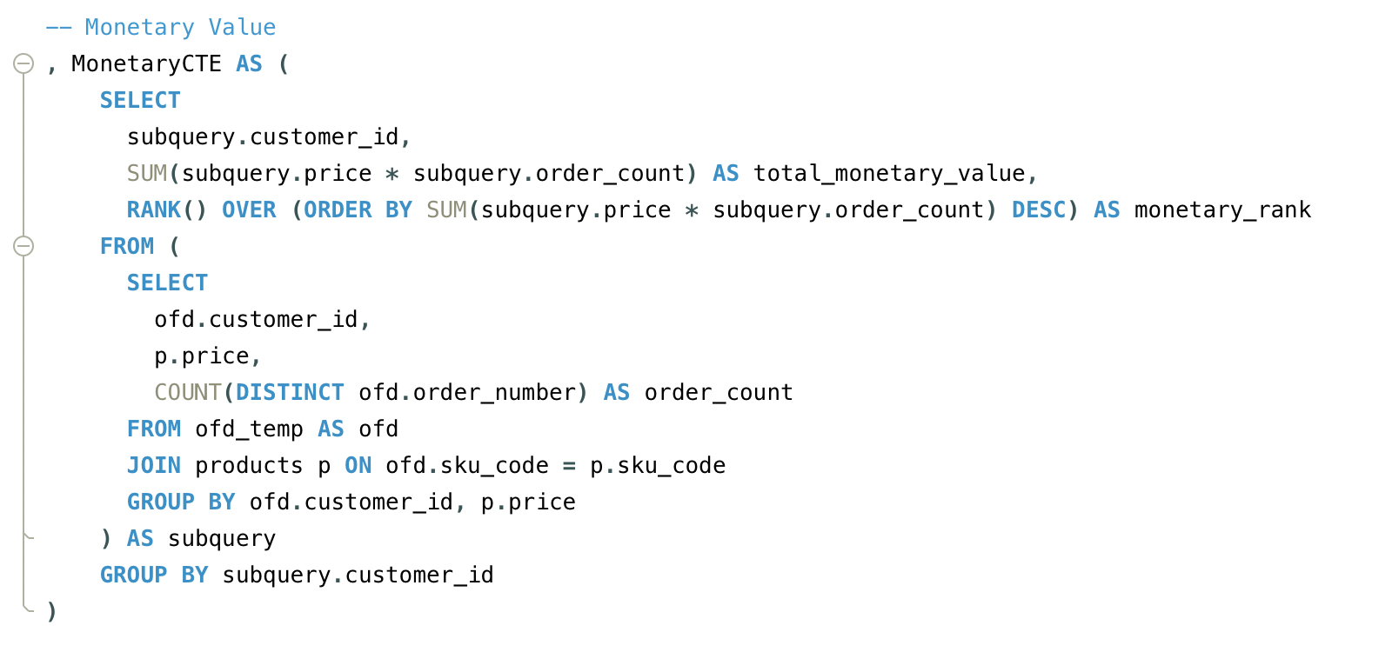
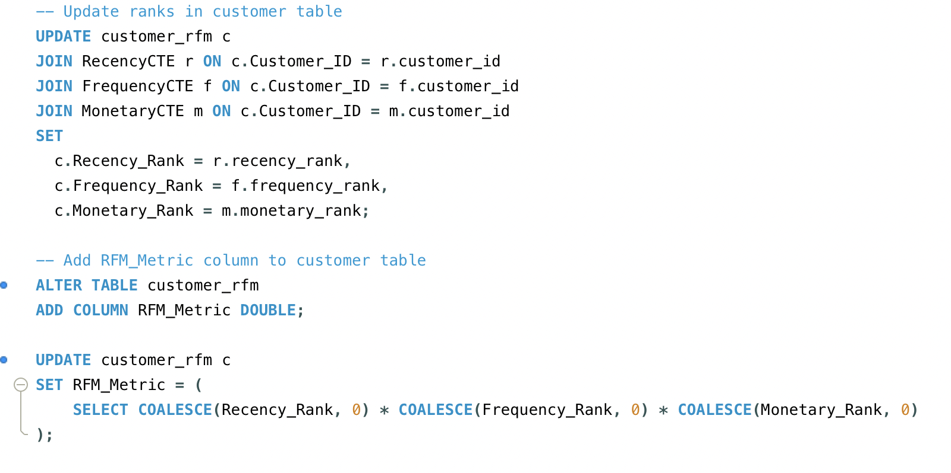
Notes:
Bhavan

Slide 11
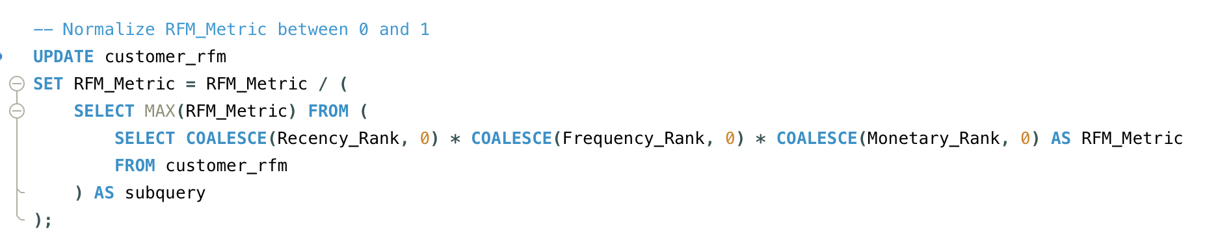
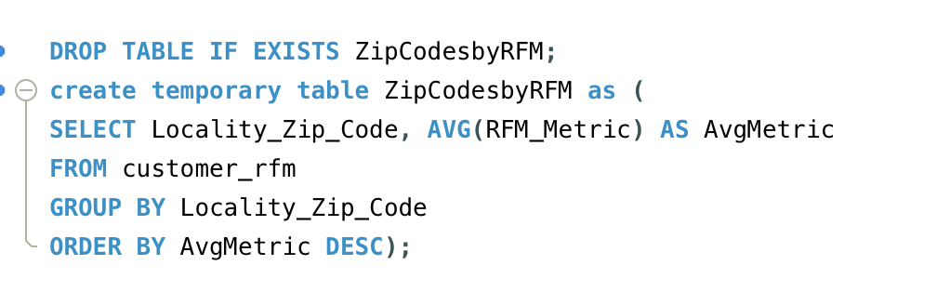
Notes:
Bhaven

Slide 12
Vendor Allocation Process
Delay Analysis Orders are analyzed for potential delays then classified into those delayed by company and those delayed by vendors using the delay status field
Vendor Re-allocation For orders with potential delays, the allocation process seeks to re-assign vendors based on criteria such as delivery costs (new price), vendor lead times (new vendor time), and vendor ratings
Decision Making Orders that can be delivered within the promised lead times by alternative vendors at a lower or comparable cost, and potentially higher vendor ratings, are re-allocated to these vendors
Special Handling We can only be sure that company-caused delays go down through vendor allocation As for vendor-caused delays, we cannot control this as it depends on driver behaviour In the future, we can incentivize drivers to reduce delays
Notes:
Anurati
Delays are caused due to two factors: misallocation of vendors by the company which we term 'company-caused delays', and delays due to drivers themselves, which we term 'vendor-caused delays'. Our project scope includes the reduction of company-caused delays through vendor reallocation. Once the orders are deployed to vendors, the delivery time is not in the company's hands. In the future, we can incentivize vendors to reduce delays using some other method.
Let's focus on company-caused delays. We label vendors based on criteria like delivery costs, vendor lead time and vendor rating. We reassign orders to vendors with lower costs and higher ratings.

Slide 13
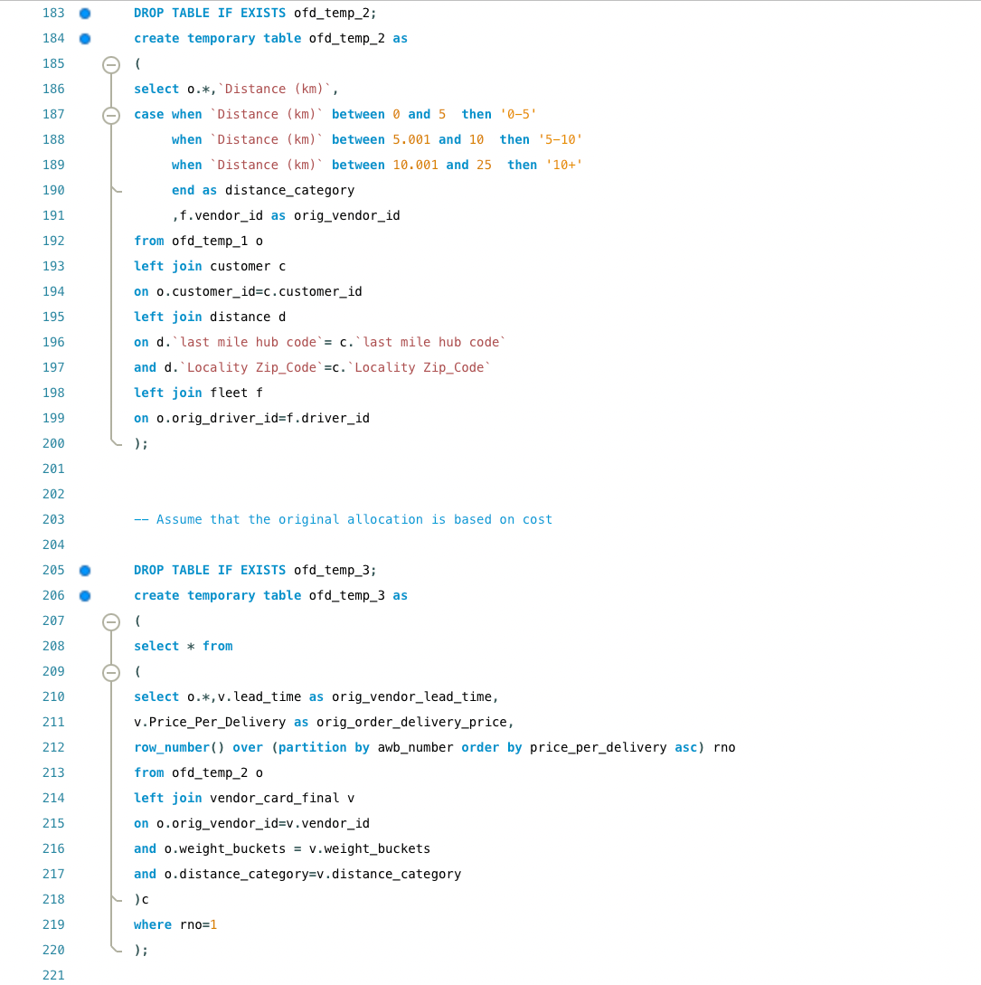
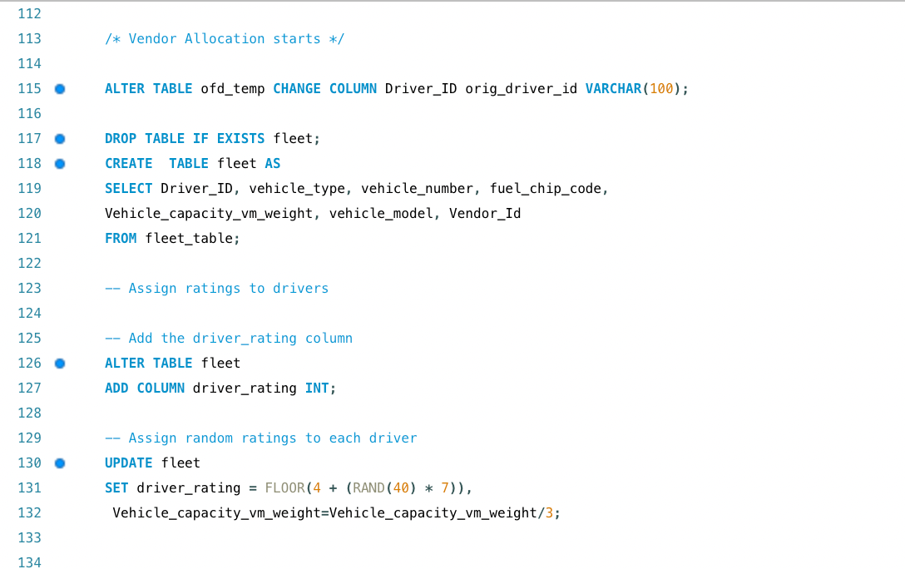
Vendor Allocation
Notes:
Anurati
Upon completion, the final allocation results are aggregated into the ofd_delays_company_alloc table. Orders are categorized into those unaffected by delays, those allocated by the company due to delays, and those requiring vendor reallocation. These results showcase a methodical approach to managing the complexities of vendor allocation, ultimately enhancing operational efficiency.

Slide 14
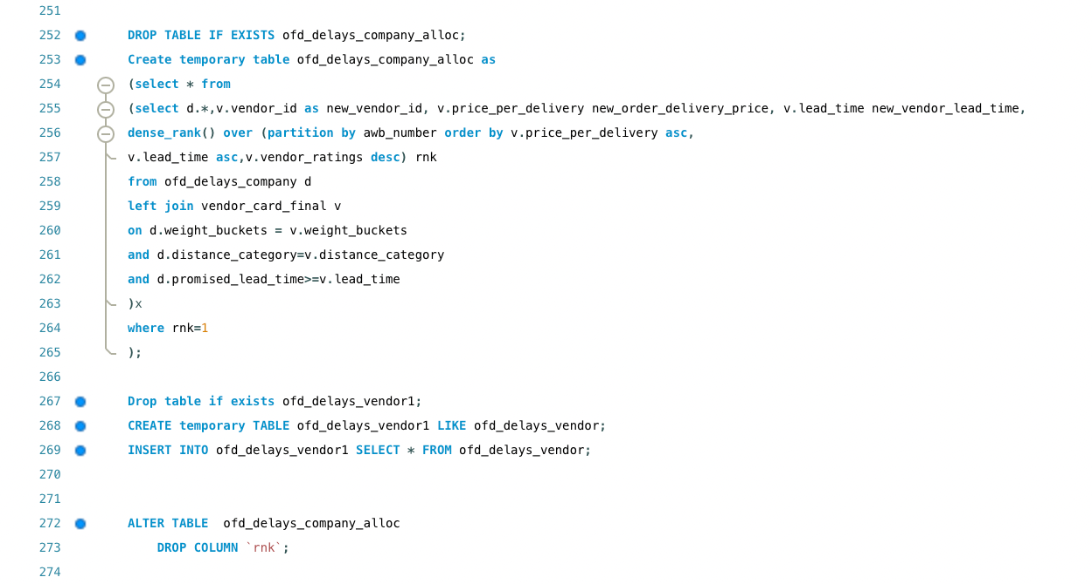
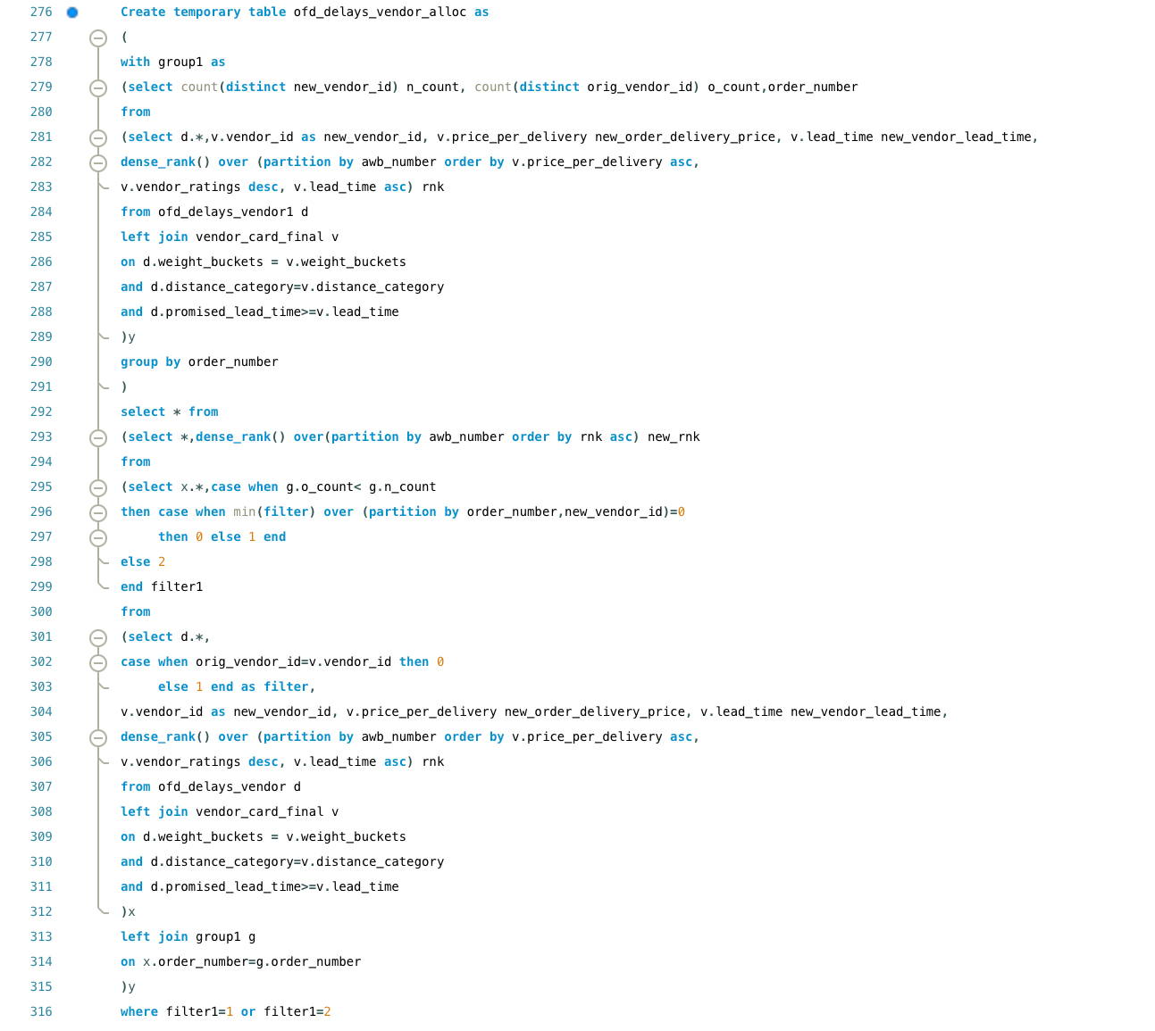
Vendor allocation
Notes:
Anurati
Now, let's dive into the process of vendor allocation within our logistics operations.
We begin by creating and manipulating temporary tables essential for our analytical purposes. These tables include ofd_temp, fleet, vendor_card_final, and ofd_temp_1. Each serves a unique function, from data randomization in ofd_temp to preparing vendor_card_final with detailed weight ranges and vendor ratings. Additionally, ofd_temp_1 is equipped with calculated lead times and volume assessments, tailoring data preparation for our final allocation strategy.
Moving forward, our vendor allocation logic employs advanced SQL constructs such as Common Table Expressions (CTEs), window functions like DENSE_RANK, and CASE statements for conditional logic. We allocate vendors based on weight buckets, distance categories, and promised lead times. Furthermore, we differentiate orders by delay status, applying distinct logic to optimize vendor selection based on cost-efficiency, lead times, and vendor performance.

Slide 15
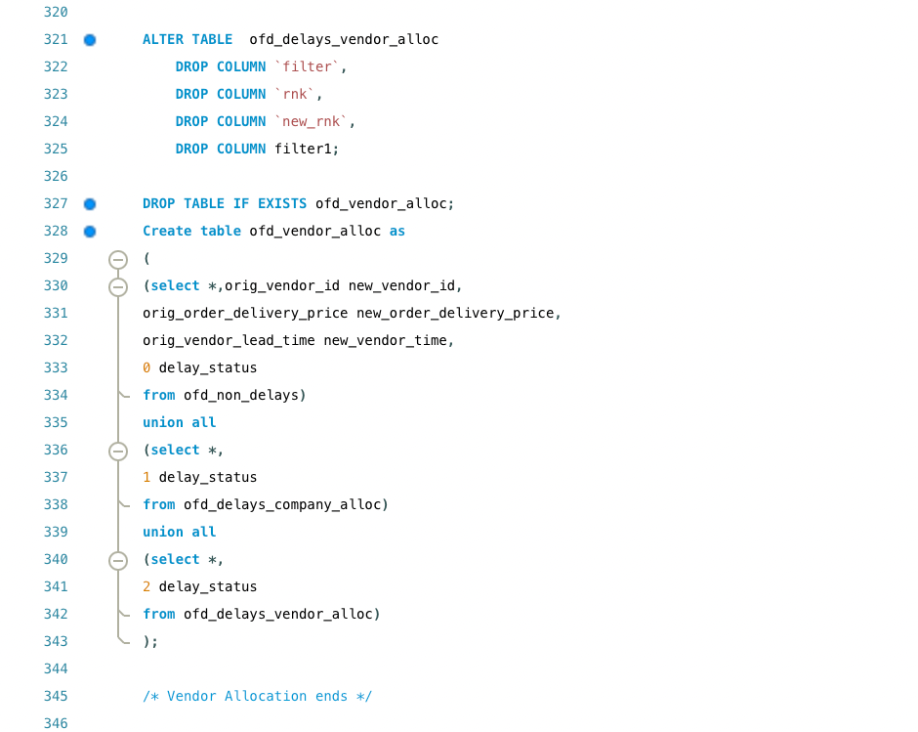
Vendor allocation
Notes:
Anurati
Now, let's dive into the process of vendor allocation within our logistics operations.
We begin by creating and manipulating temporary tables essential for our analytical purposes. These tables include ofd_temp, fleet, vendor_card_final, and ofd_temp_1. Each serves a unique function, from data randomization in ofd_temp to preparing vendor_card_final with detailed weight ranges and vendor ratings. Additionally, ofd_temp_1 is equipped with calculated lead times and volume assessments, tailoring data preparation for our final allocation strategy.
Moving forward, our vendor allocation logic employs advanced SQL constructs such as Common Table Expressions (CTEs), window functions like DENSE_RANK, and CASE statements for conditional logic. We allocate vendors based on weight buckets, distance categories, and promised lead times. Furthermore, we differentiate orders by delay status, applying distinct logic to optimize vendor selection based on cost-efficiency, lead times, and vendor performance.

Slide 16
Driver Allocation Process
Assess performance Add a performance score field to the fleet table, assigning scores to drivers based on a predefined formula Scores range from 4 to 10, ensuring fairness among drivers
Order Management and Route Planning Generate a temporary orders table recording all orders and their volumes. Log order origins and previous hubs to aid in route planning and logistical coordination.
Real-time Allocation Optimization Create a dynamic view within the database showing driver-to-order assignments. Base assignments on performance ratings and vehicle capacities, adapting to real-time changes efficiently
Central Allocation Table Management
Keep the central allocation table current by updating driver-order pairings.
Quickly adjust assignments in response to delays to ensure optimal driver allocation.
Notes:
Saurav
First, we initiate the performance assessment phase by integrating a performance score field into our fleet database. This score, ranging from 4 to 10, is meticulously calculated using a predefined formula to ensure fairness among our drivers.
Moving on, we strategically adjust vehicle capacities within the database, scaling them down to a third of their original size. This adjustment isn't arbitrary; it's a calculated move aimed at enhancing load management and overall operational efficiency.
Next, we focus on order management and route planning. A temporary orders table is generated, capturing all incoming orders along with their respective volumes. Additionally, this table logs crucial details such as order origin and the previous hub in the delivery chain, providing invaluable insights for effective route planning and logistical coordination.
Lastly, we implement real-time allocation optimization through the creation of a dynamic view within our database. This view acts as a live chart, dynamically assigning drivers to orders based on their performance ratings and vehicle capacities. This adaptability ensures efficient order allocation, even in the face of real-time changes and challenges.
By meticulously orchestrating these database queries, we maintain an up-to-date and optimized delivery system. This structured approach not only enhances efficiency but also reinforces the reliability of our delivery service, ensuring timely and accurate deliveries every time.

Slide 17
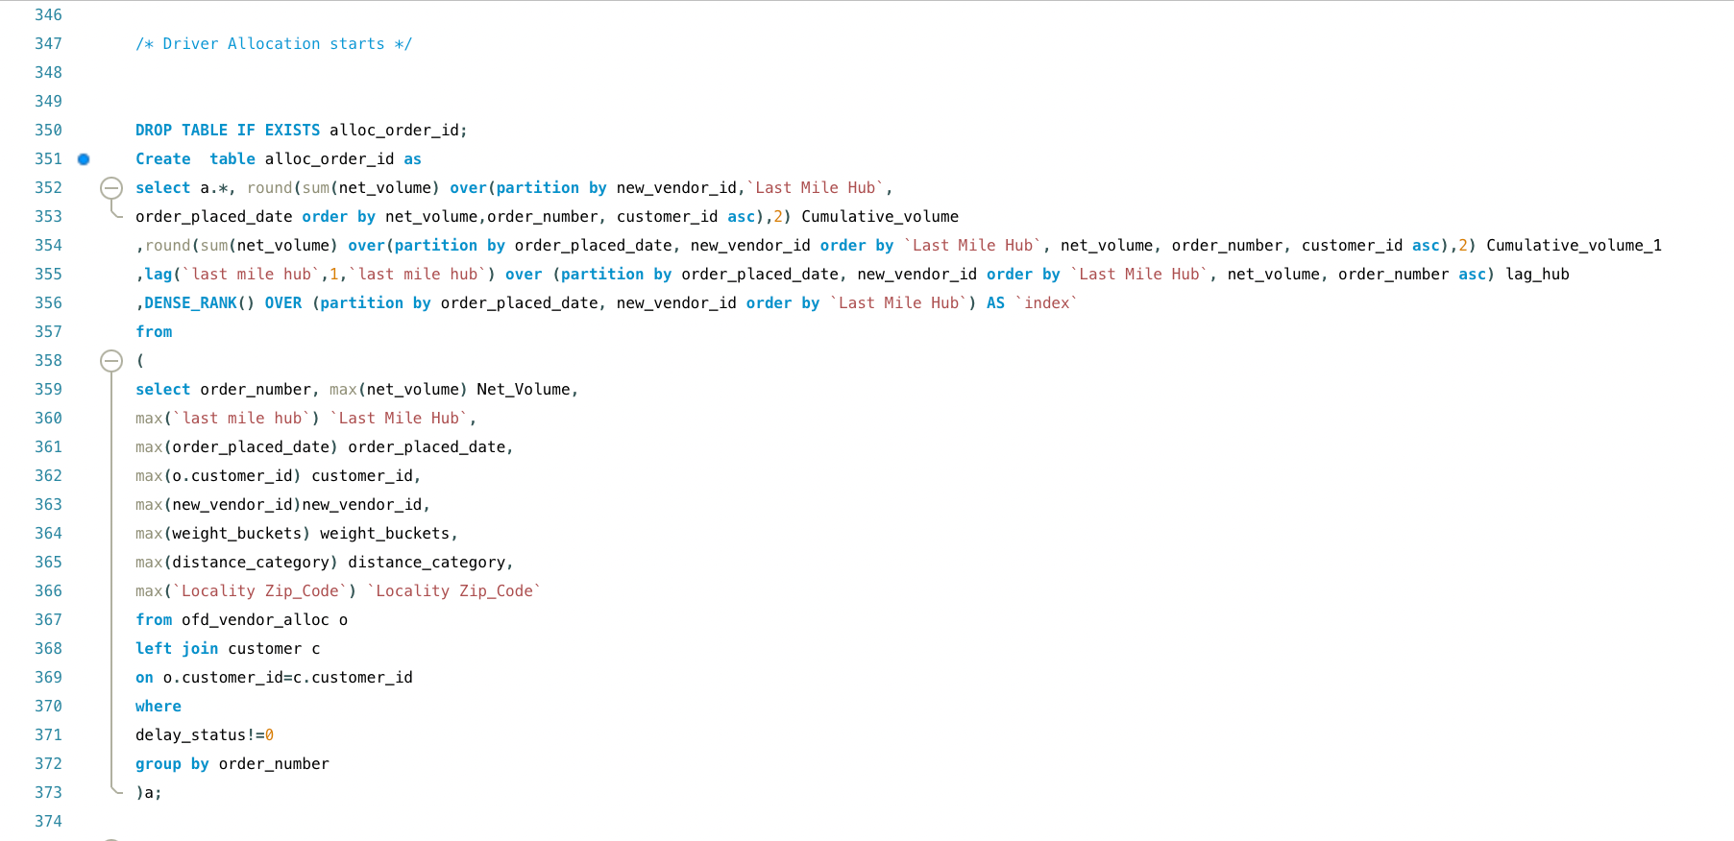
Driver allocation query
Notes:
Saurav

Slide 18
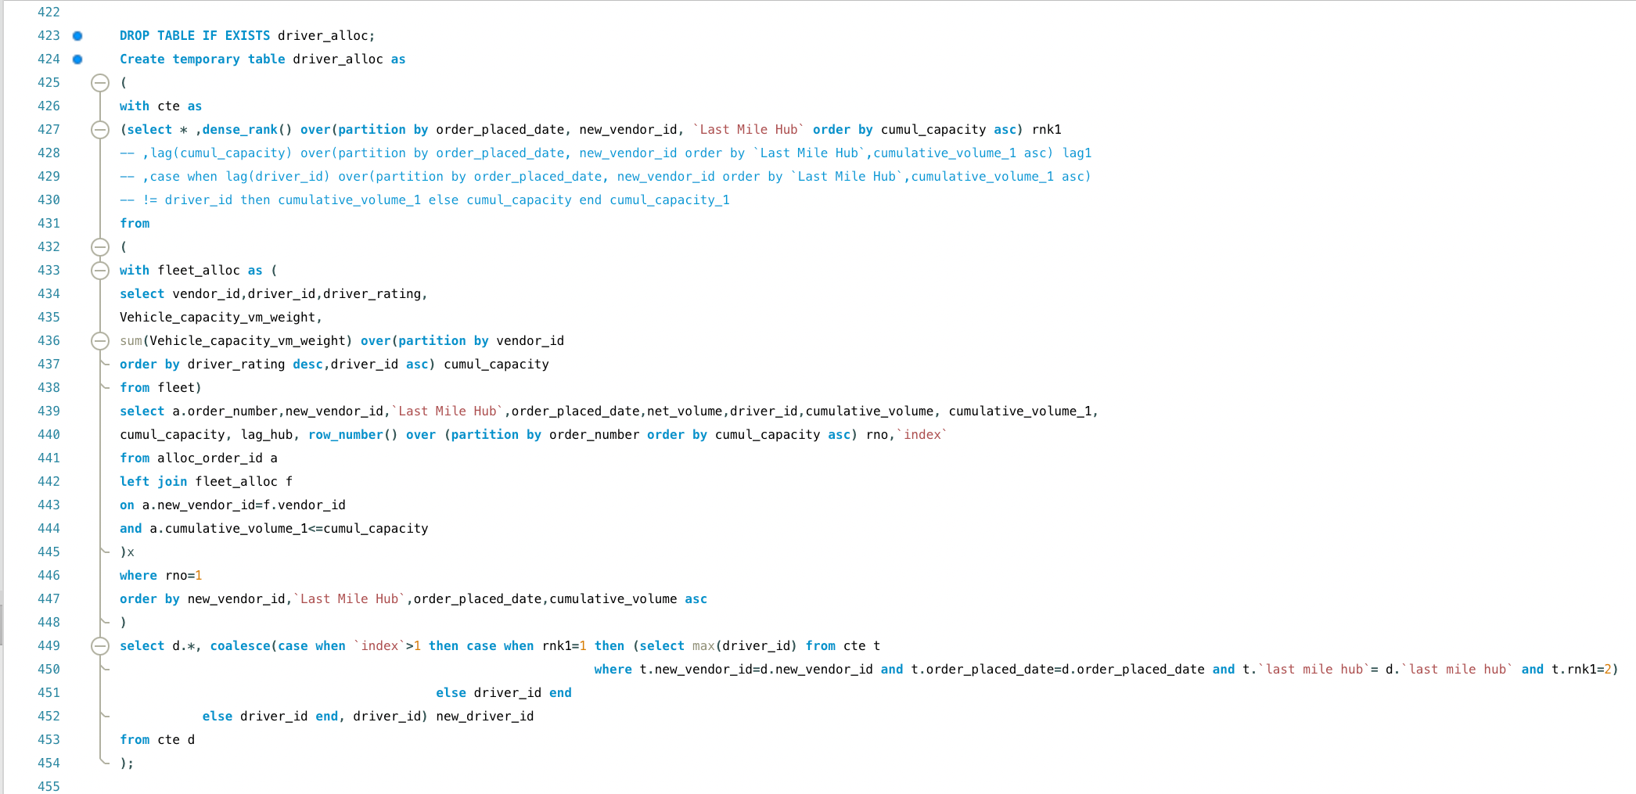
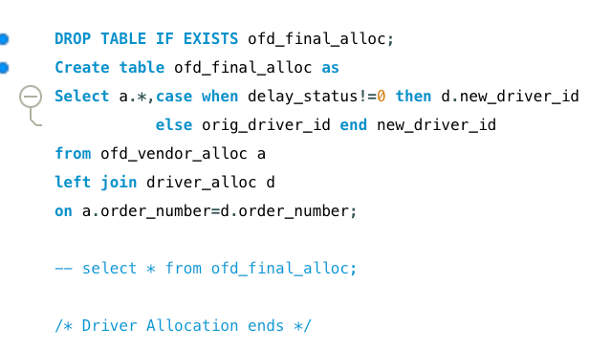
Driver allocation query
Notes:
Saurav

Slide 19
Capacity Allocation Analysis
c
Capacity utilization The process of driver allocation is optimized to maximize capacity utilization of vehicles. The objective is to improve operational efficiency and decrease spending on fuel.
Cost per order The cost per order is the target metric to reduce. The is the objective of the optimization process.
Streamlining deliveries Drivers make the best out of each trip they take. This results in quicker and more efficient deliveries.
Quality assurance Priority customers get not only vendors with high ratings but also drivers that have high scores. This assures a quality for priority customers thus increasing customer retention.
Notes:
Kavya

Slide 20
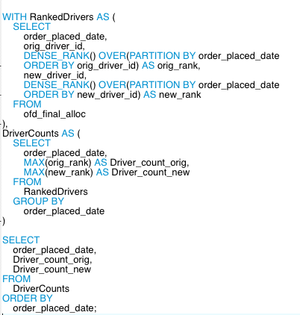
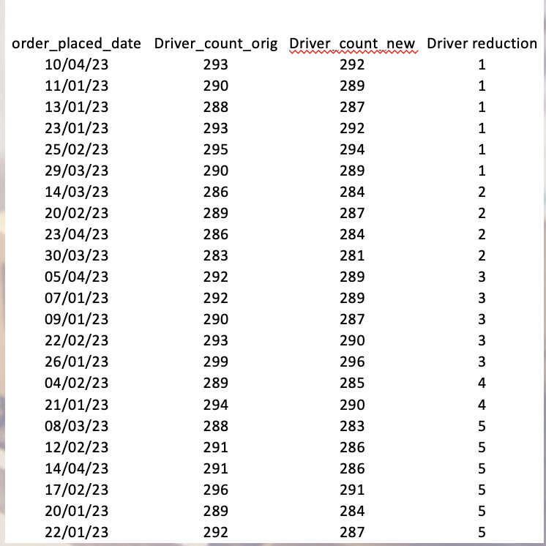
Capacity Allocation Analysis
Notes:
Kavya
With the vendor and driver reallocation initiative, we also ensured that drivers assigned to a specific zone are responsible for delivering all orders within that zone. This optimization has led to a noticeable reduction in the total number of drivers required in the field each day, averaging a decrease of 3 drivers per day for the study period of 4-months. This adjustment not only contributes to a significant reduction in manpower costs but also enhances resource utilization efficiency. Moreover, by consolidating deliveries within specific zones to fewer drivers, we have achieved an improvement in vehicle capacity utilization. This, in turn, has resulted in lower fuel consumption, further aligning with our goals for operational efficiency and environmental sustainability.

Slide 21
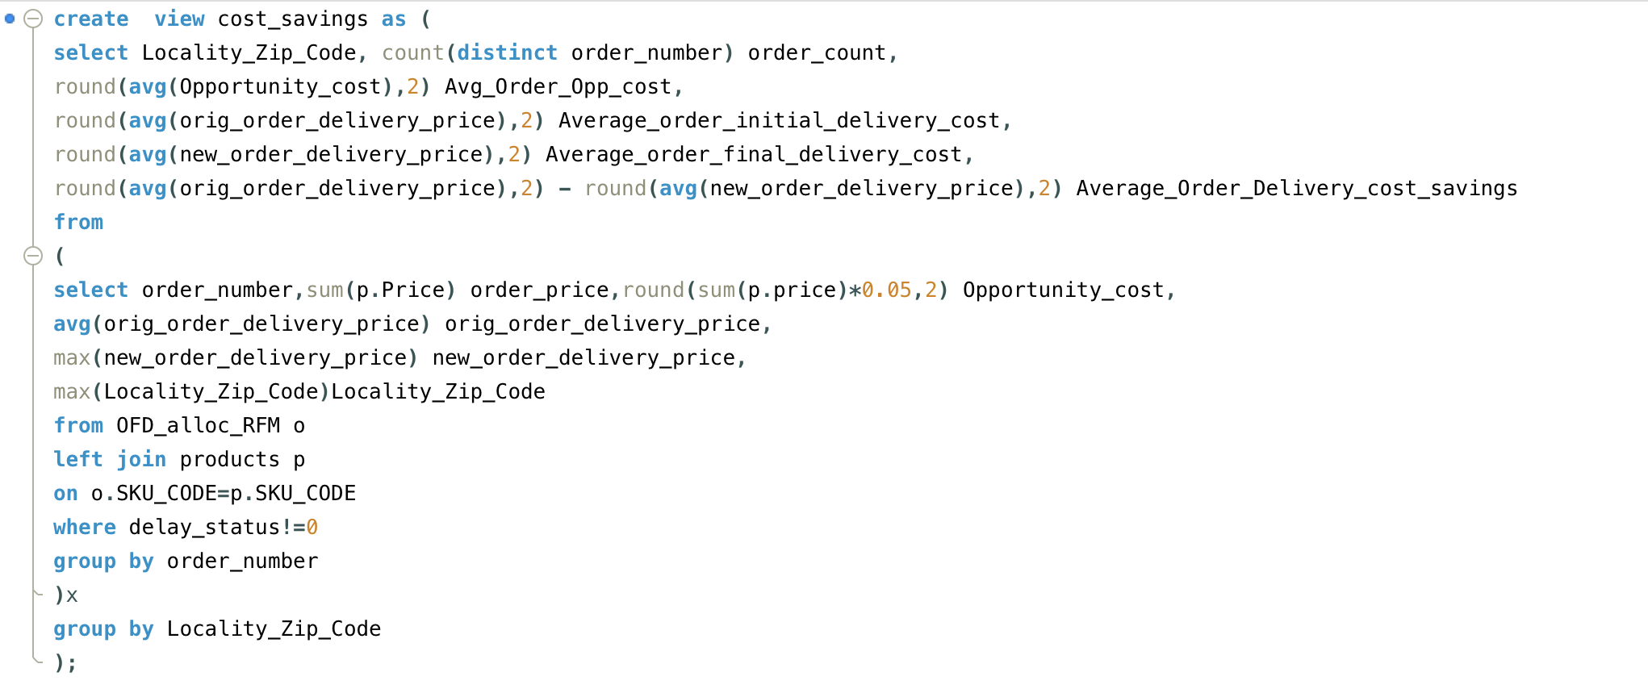
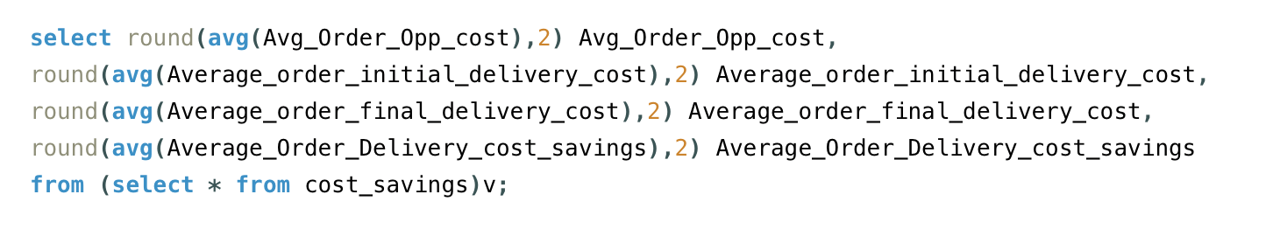
Cost Saving Analysis
Net Cost Saving
Output
Notes:
Kavya
This is the assessment of our cost savings achieved through strategic vendor reallocation, leveraging SQL queries to quantify the financial benefits accurately. A critical component of our evaluation involved calculating the opportunity cost associated with delayed orders, which, according to an agreement with our client, represents a 5% revenue loss per delayed order . This calculation provided a foundation for understanding the direct impact of delays on our bottom line.
Further, our analysis revealed significant cost savings stemming from the reallocation of vendors. We identified that certain vendors, despite charging premium rates, were associated with lower performance ratings and longer lead times. By reallocating orders to more efficient vendors, we achieved an average cost saving of $1.15 per order. Given our company's volume of approximately 1,000 orders per day, this translates to daily savings of $1,150. Over the course of a year (assuming 300 operating days), these savings amount to $345,000.

Slide 22
Final Output
zipcode | Average of RFM_Metric | Company Avg delay | Final Company Avg delay | CPO (Initial) | CPO (Final) | Average_Order_Delivery_cost_savings
60074 | 0.245 | 2.92 | 0 | 9.72 | 9.06 | 0.66
60988 | 0.243 | 2.85 | 0 | 10.41 | 9.23 | 1.18
60317 | 0.200 | 2.78 | 0 | 10.39 | 9.06 | 1.33
60227 | 0.175 | 2.98 | 0 | 10.45 | 9.31 | 1.14
60834 | 0.173 | 3.43 | 0 | 11.74 | 10.43 | 1.31
60045 | 0.164 | 3.02 | 0 | 21.40 | 18.96 | 2.44
60852 | 0.164 | 2.45 | 0 | 19.51 | 17.46 | 2.05
60790 | 0.153 | 2.67 | 0 | 21.59 | 18.53 | 3.06
60516 | 0.152 | 2.89 | 0 | 10.91 | 9.98 | 0.93
60582 | 0.147 | 2.69 | 0 | 10.18 | 8.86 | 1.32
60855 | 0.145 | 3.25 | 0 | 9.72 | 9.14 | 0.58
60612 | 0.144 | 3.13 | 0 | 19.30 | 16.22 | 3.08
60422 | 0.139 | 3.68 | 0 | 9.32 | 8.04 | 1.28
60824 | 0.139 | 2.64 | 0 | 10.36 | 9.35 | 1.01
60813 | 0.138 | 3.45 | 0 | 11.44 | 10.52 | 0.92
60167 | 0.133 | 2.80 | 0 | 20.83 | 18.29 | 2.54
60609 | 0.128 | 3.09 | 0 | 10.43 | 9.38 | 1.05
Notes:
Liana
The metrics here are grouped by the zip code after the reallocation process and here the average of the RFM metrics explained earlier is here. The next column shows the average company delay before the reallocation process then the final reduced delay for the company after the analysis. Out of the scope of this analysis was the vendor delays as that is something that isn’t really in the company’s control and would involve contract negations between the vendors. Next we have he average cost per a delivery (CPO) and the reduced CPO in the next column. The last column is the difference between the previous two columns. The cost savings will benefit both the customers and the company leading to better customer satisfaction and a streamlined delivery services

Slide 23
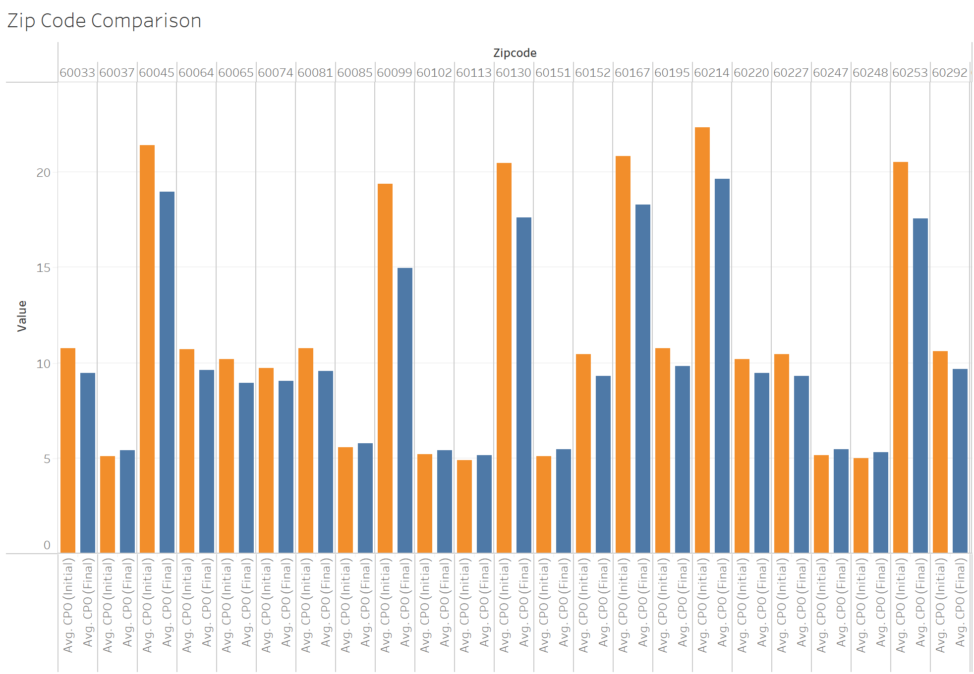
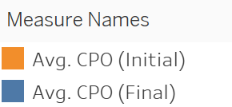
Final Output
Notes:
Liana
This graph displays a before and after of average delivery cost after the reallocation process.

Slide 24
Future Scope and Recommendations
Dynamic Delivery Pricing Analyze the feasibility of dynamic pricing based on time of day or week, using time-stamped order data and machine learning to predict demand and set prices
Customer Segmentation and Personalization Enhance customer segmentation using machine learning for personalized marketing, leveraging web browsing behavior and social media data
Scalable Data Analysis System Upgrade to a real-time analysis system integrating with a streaming data platform and real-time processing frameworks for immediate operational insights
Predictive Analytics for Inventory Management Apply time series forecasting models to optimize inventory levels based on historical sales data and market trends
Optimization of Vendor and Driver Allocation Use advanced optimization algorithms considering cost, delivery time, and customer satisfaction for efficient resource allocation
Dynamic Rating System for Vendors and Drivers Implement a system evaluating performance with customer feedback and order accuracy data, employing sentiment analysis and statistical methods
Notes:
Liana
Dynamic Delivery Pricing
- With the updated system, feasibility analysis for dynamic pricing based on the time of day or day of the week. This would be possible if there are time-stamped order data and the ability to implement machine learning tools to predict demand and set the prices accordingly
Dynamic rating system for vendors and drivers
- implement a system for evaluating the performance using customer feedback and order accuracy data. This would allow the company to implement a sentiment analysis to quantify how customers feel about the products
Customer Segmentation and Personalization
- Customer segmentation can be implemented using machine learning for personalized marketing and leveraging consumer’s web behaviors
Scalable data analysis System:
-upgrade to enable real-time analysis using a cloud system to integrate streaming data and implement a real-time processing framework for immediate operational insights
Predictive analytics for inventory management:
-Apply time series forecasting models to optimize the inventory levels based on the historical sales and data and market trends
Optimization of Vendor and Driver allocation:
- Using the analysis we provided the company should be able to implement the suggested improvements

Slide 25
Thank You!

